Slide 1
Statistical Modelling with Python
Data Cleaning & analyzing
Building a Model
Data Visualization
Use API For collect data

Slide 2
Project/Goals
The project’s main goal is to collect data from different APIs like CITY BIKE API, FOURSQUARE API & YELP API.
To analyze data which collect from various APIs & clean data to remove duplicates and irrelevant values & make data more sensible and useful.
Then, create data visualization which helps understand data in the easiest way.
Generate regression model which is the relationship between multiple independent variables and one dependent variable.

Slide 3



Tool Installation & Set Up
Use Jupyter lab for python programming.
Use Visual Studio for editing files which clone from GitHub.
Use GitHub for storing files of project data and share on local server it is easy way to access and store data.

Slide 4
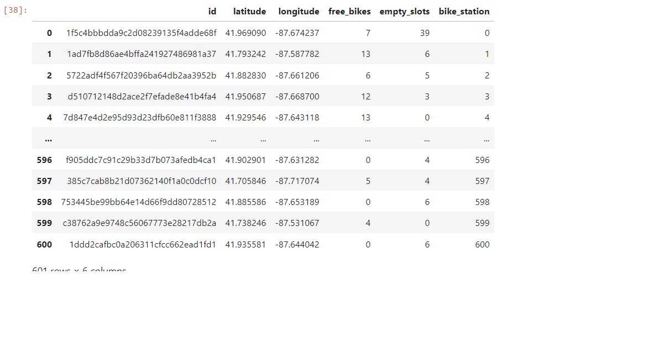
Use City bike API for collect data for bike
I select Chicago City to collect data on bike details.

Slide 5


Collect data from different APIs
Collect data on Bars for each bike station using foursquare API and collect data on Restaurants for each bike station using Yelp API.
Foursquare API provides more complex data compare to Yelp API because it gives more data for each bike station location.

Slide 6
Data Analysis and Data Cleaning
In Data Analysis, Analyze data and check whether we got appropriate data or not and check each value in the data set.
In Data Cleaning,
Remove Duplicate values from data.
Remove Null values
Remove Irrelevant column.
Notes:
When conducting research, it is easy to go to one source: Wikipedia. However, you need to include a variety of sources in your research. Consider the following sources:
Who can I interview to get more information on the topic?
Is the topic current and will it be relevant to my audience?
What articles, blogs, and magazines may have something related to my topic?
Is there a YouTube video on the topic? If so, what is it about?
What images can I find related to the topic?

Slide 7
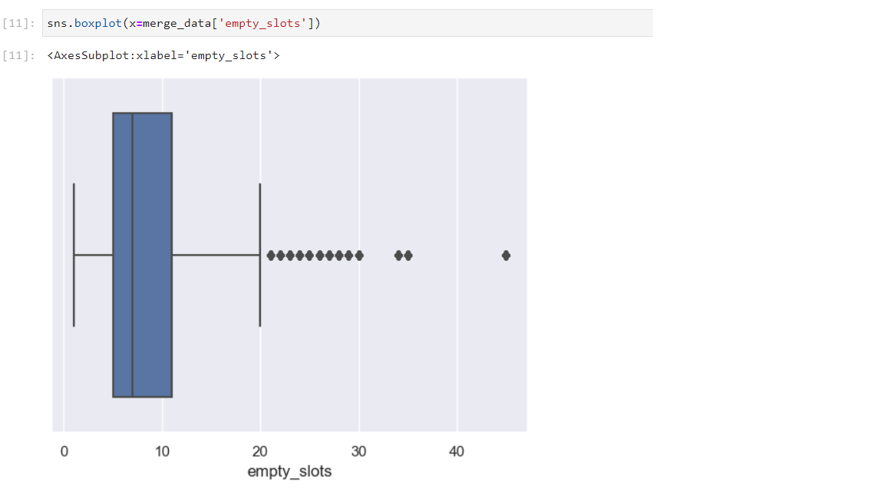
Data Visualization
DETECTING OUTLINERS

Slide 8
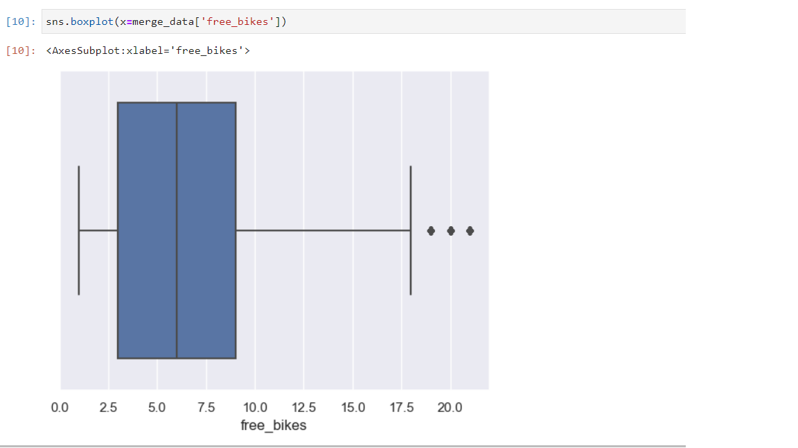

Slide 9
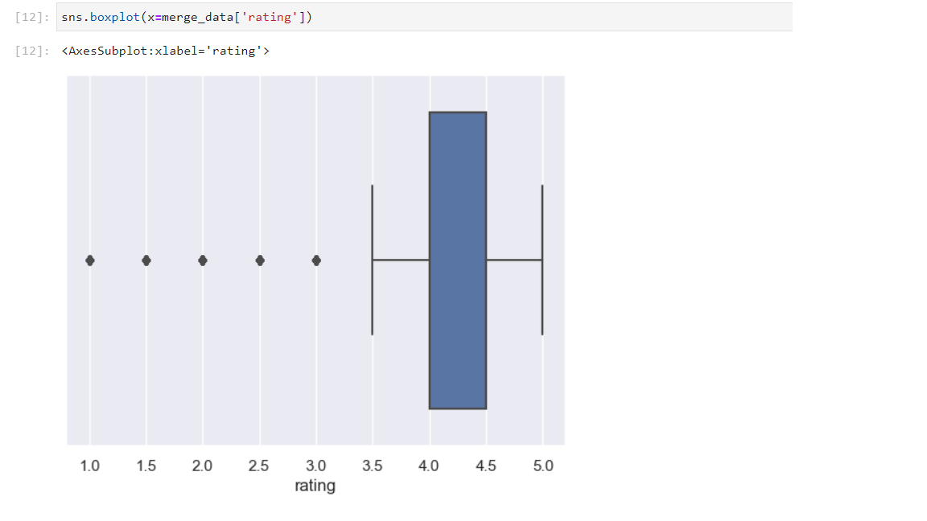

Slide 10
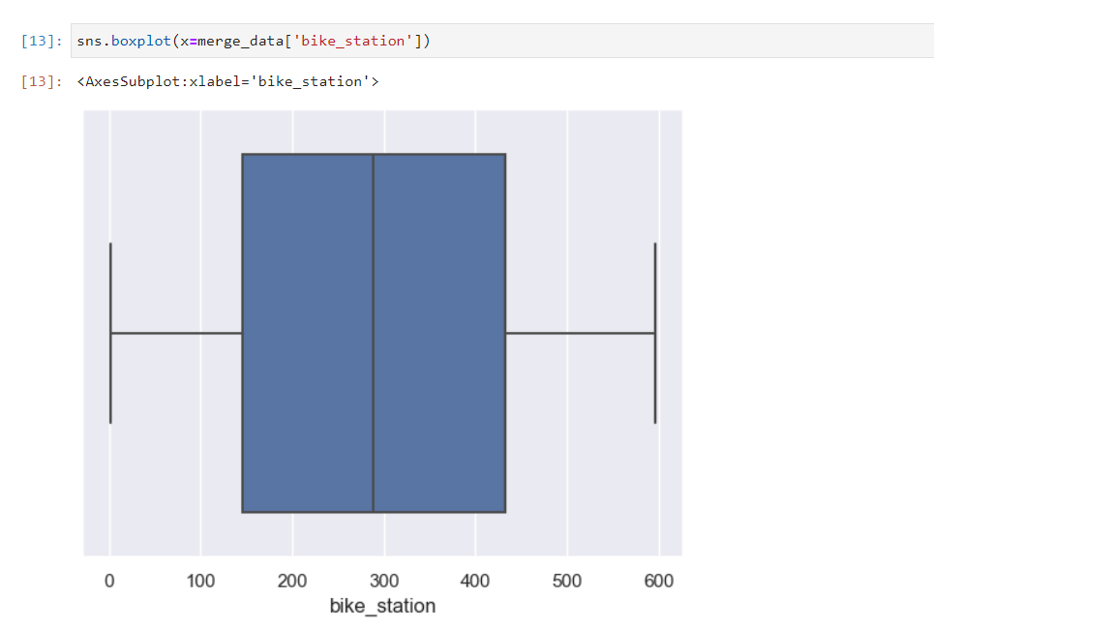

Slide 11
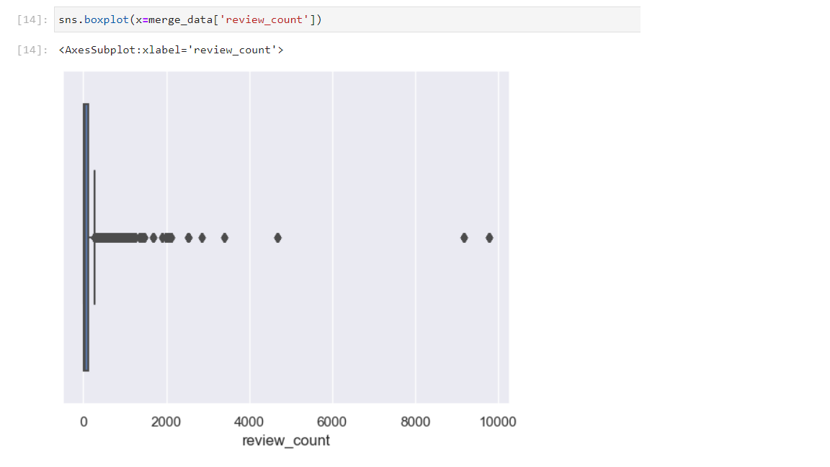

Slide 12
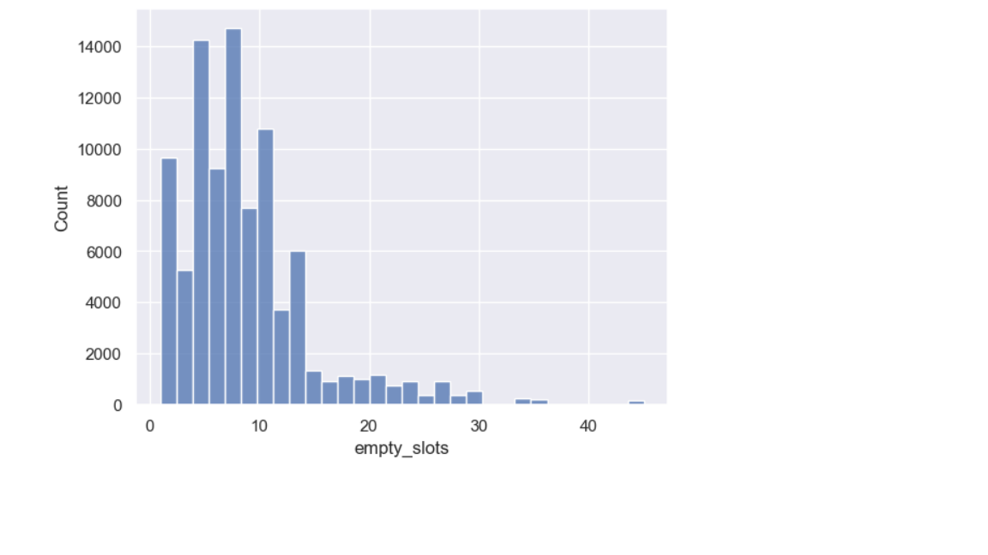
Histogram of empty slot

Slide 13
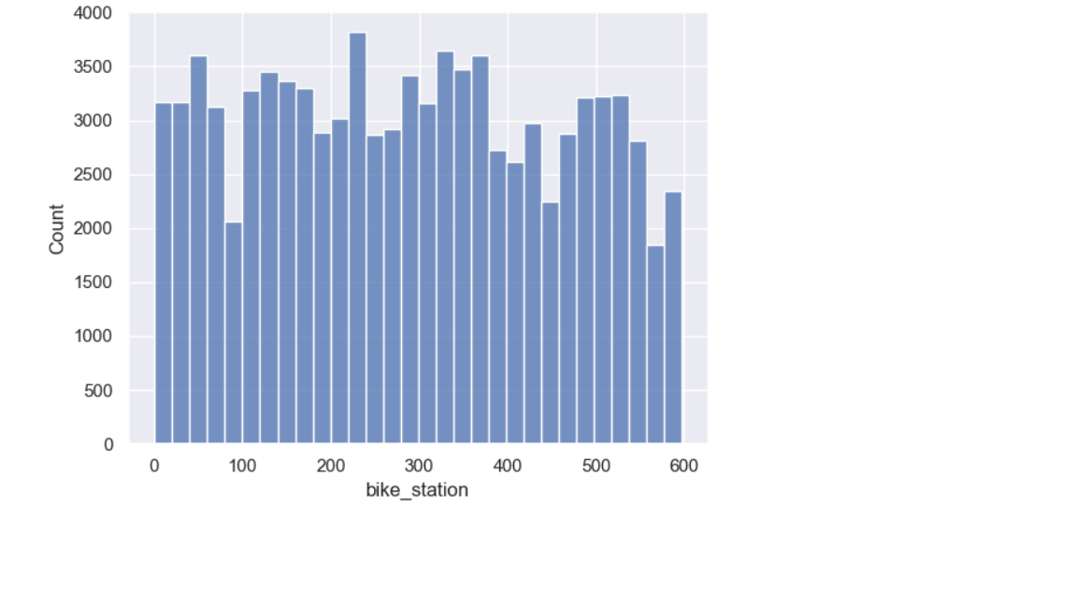

Slide 14
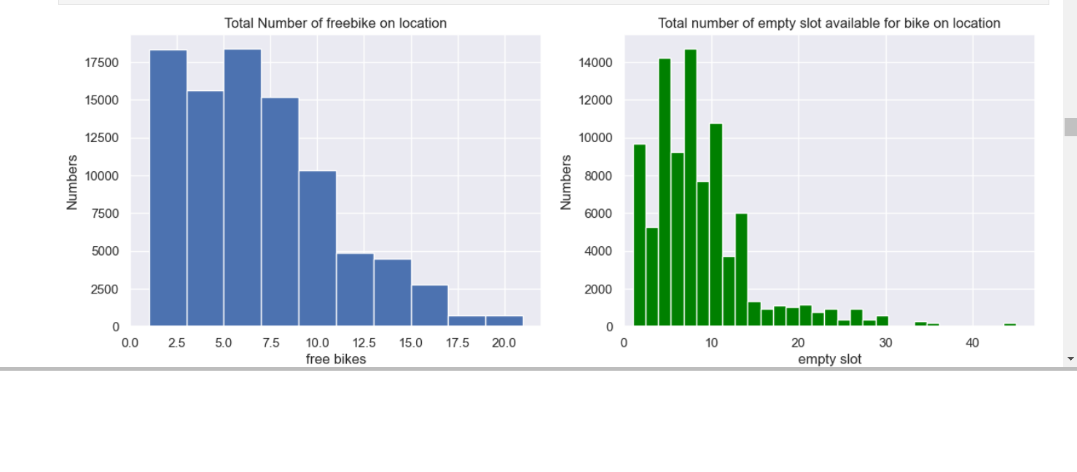

Slide 15
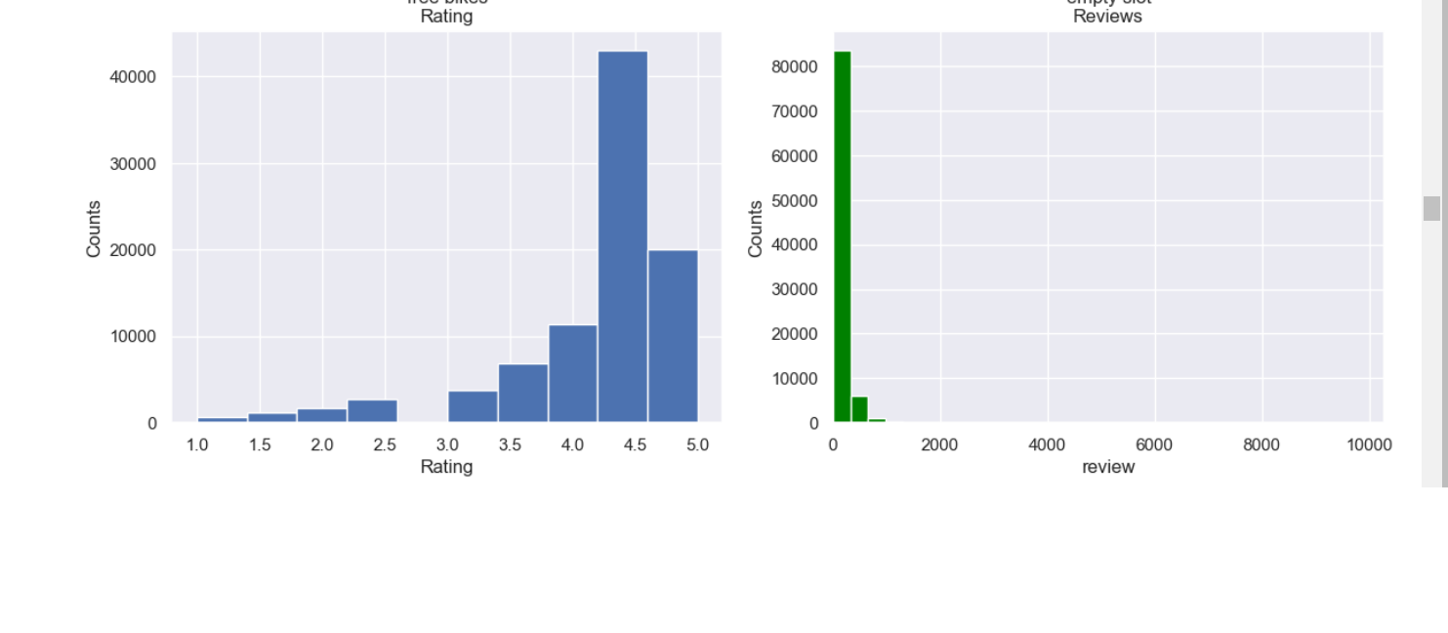

Slide 16
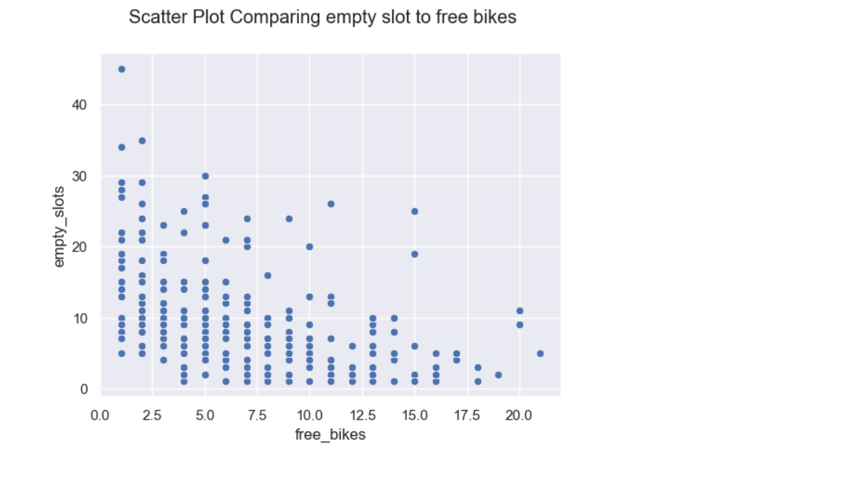

Slide 17
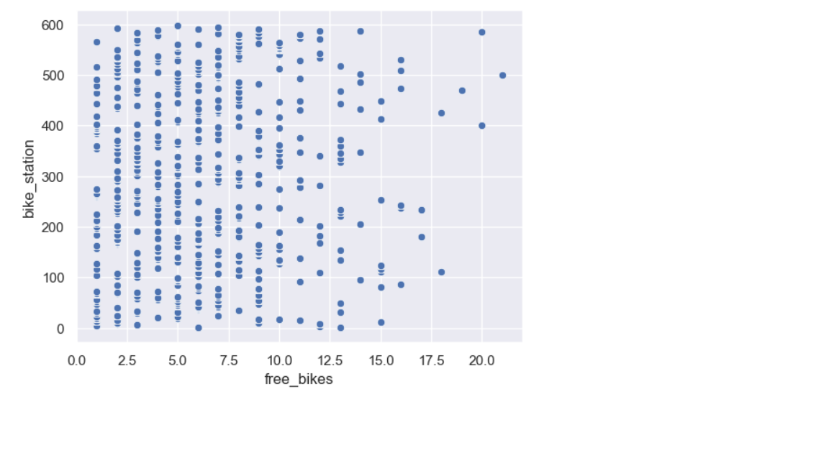

Slide 18
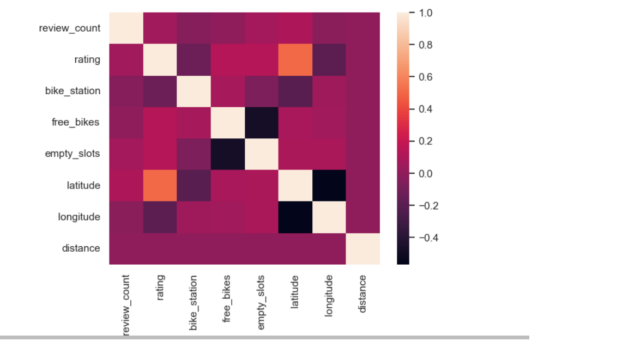

Slide 19
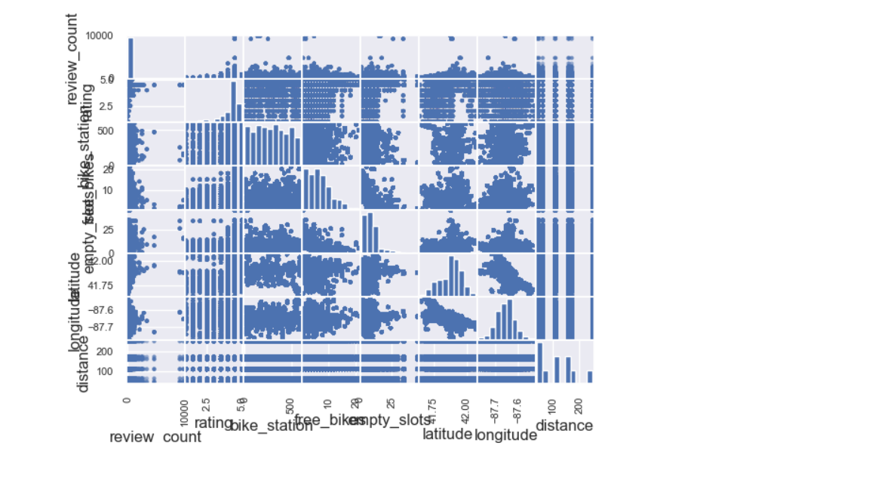

Slide 20
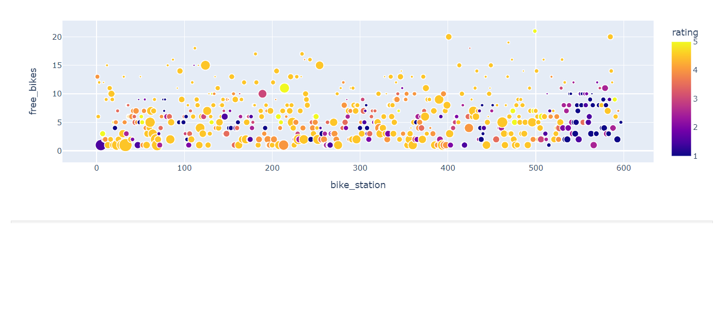

Slide 21
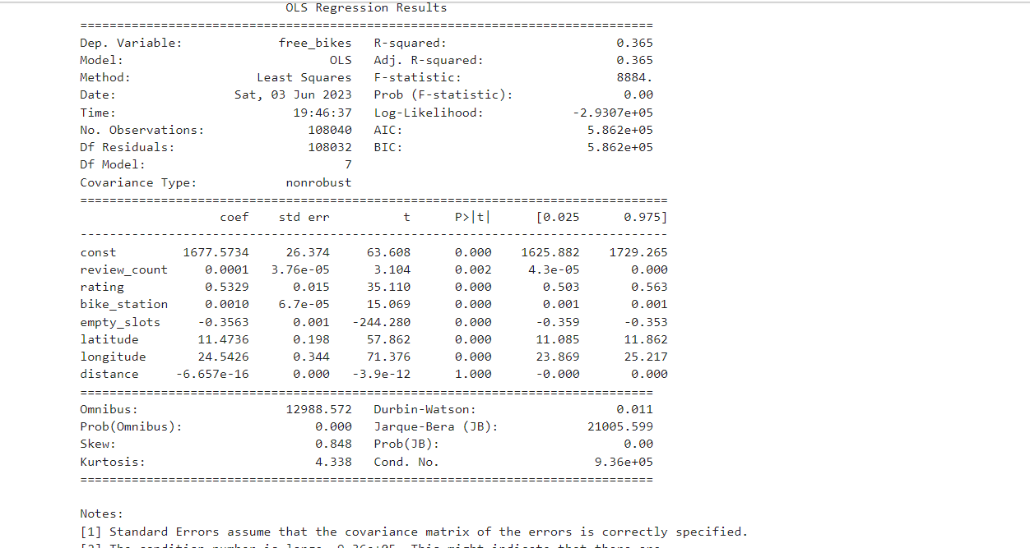
Model Building

Slide 22
The Regression model is not a good fit because the value of R square is too low.
p-value is zero so that in the model output shows the effect of each variable is too low on outcome.
Notes:
Now, that you have narrowed your topic, you will want to organize your research in a structure that works. There are some common organizational patterns based on the kind of research you are doing.
Organizational Structures:
Cause and Effect- this kind of structure is great for explaining the causes and effects of a topic
Compare and Contrast- in this pattern you highlight the similarities and differences of the topic
Explain process- this structure is great for outlining a series of steps to follow;
Definition- if you want to make sure your audience understands what something is using illustrations, meanings, clarifying misconceptions, you may want to use this structure
Classification- a common organizational structure is grouping like topics or facts from the research together. For instance, in the internet safety about social media apps, you may organize the research where you look at each social media app one at a time

Slide 23
Challenges
(1) Extract data from APIs.
(2) Difficult to store API key in the environment.
(3) When I deleted duplicate data from Data Frame I lost many rows of data.
(4) When I merge data, I got too complicated data
(5) Model Building I did not get proper Output.

Slide 24
Future Goals
If I have time I properly analyze data and try to understand data and I will do with better with visualization and modeling.

Slide 25
THANK YOU

